Slide 1

Literature Research
for
IMMD Ver.2 Design
Mesut Uğur
06/10/2018
mesut.ugur@metu.edu.tr

Slide 2
Content
Types of faults in a motor drive
Fault tolerant topologies (non-modular)
Fault tolerant topologies (modular)
Isolation requirements
Short circuit current and inductance
Stator winding configurations for a modular machine
Multi-phase modular machines
Fault detection and operation under fault
Applications
High speed machines - evaluation
Fractional Slot Concentrated Winding machines (Windings, Slots, Poles etc.)
Fault Tolerant PMSM Design Tips

Slide 3
Types of faults
Winding open-circuit faults
Winding short-circuit faults;
inter-turn short-circuit faults,
coil to coil faults,
line to line faults
line to ground faults
Transistor short-circuit faults
Transistor open circuit faults
DC bus capacitor faults.
Power supply failure or AC line fault in mains supplied rectifier
Sensor failure.
Control equipment failure
Bearing faults.
Static and dynamic eccentricity conditions (due to a bent shaft or a shaft misalignment).
Gearbox faults in non direct-driven machines.

Slide 4
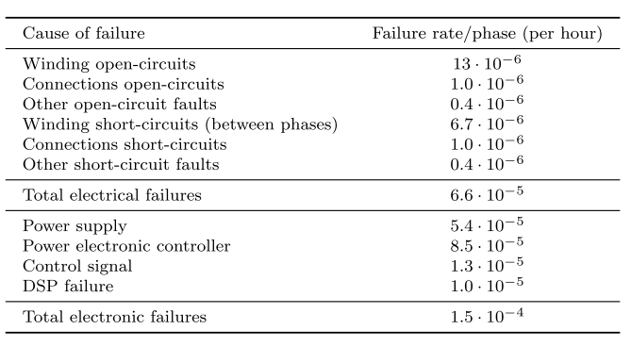
Failure Rates
Observations:
Control signal & DSP fault rates are similar to open-circuit fault, and higher than short circuit fault
Power electronics has the highest failure rate
Power supply failure rate is similar to the sum of the machine failure rates

Slide 5
Open circuit faults
Winding open-circuit faults:
among the most common faults.
caused as a consequence of:
the internal interruption of the motor windings
mechanical faults at the machine terminals
mechanical stresses on the connectors that link the motor and the inverter
by an electrical failure on an inverter phase leg
leads to the inability to produce a standard 3-phase constant magnitude rotating magnetic field
causes large torque pulsations, mainly at twice the frequency of the supply signal

Slide 6
Short circuit faults
Majority of stator winding faults begin as insulation breakdown failures that lead to a short-circuit between several turns of a phase winding.
causes a large circulating current that generates a high amount of heat to be locally released within a short time.
If undetected, inter-turn short-circuit faults rapidly propagate to neighboring turns, culminating in major faults such as coil to coil, phase to phase, phase to ground or open-circuit faults
Winding short-circuit faults involving the whole phase winding:
may happen as a consequence of
the closing of all the high side or low side switches of the inverter,
a DC bus short-circuit,
a short-circuit between machine terminals in the terminal box
physical damage on the cables connecting the motor and the inverter
FSCW’lerde, özellikle alternate teeth ise, phase-to-phase olması zor.
Slotta olan fault slotta kalır…
All-tooth ise, aynı slottaki sargıları iyi izole ederek sağlanabilir. End-winding’ler zaten değmeyecek.

Slide 7
Transistor open circuit
One of the most common inverter faults involves the permanent opening of a power semiconductor switch
due to damage to the transistor itself or the control logic commanding the gate signals.
current in the corresponding inverter leg is allowed to flow only during part of electrical cycle,
either through the other transistor or through the associated free-wheeling diode (bu GaN’da olmayacak mesela)
leading to a DC component in the phase currents and pulsations in the torque waveform
may remain undetected for a long time

Slide 8
Transistor short circuit
Transistor short-circuit faults usually occurs as a consequence of a single power semiconductor switch being permanently damaged.
The damage may be due to
a short-circuit fault in the associated free-wheeling diode
presence of impurities in the fabrication process may also trigger the short-circuiting of the power semiconductor switch.
erroneous control signals caused by driver malfunction
auxiliary power supply failure
electromagnetic disturbance
control software errors
serious fault condition that demands immediate remedial action
the other switch in the same leg has to be opened within a few µs
As a consequence of the fault, high magnitude DC current components that are mainly limited by the stator resistance appear in all the phases
poses a risk in terms of
current withstand capability of the remaining healthy transistors,
winding overheating
PM demagnetization
An extremely high and oscillating torque is produced

Slide 9
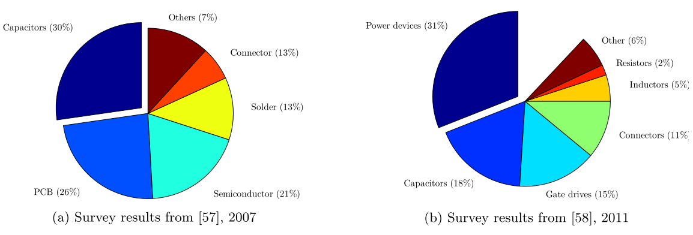
Fault Fun Facts
Among the stator related faults (37%), 23% were due to failures of the ground insulation and 4% due to turn insulation faults. (1982)
In slow speed motors (up to 720 rpm), the main cause of machine failure were failures in the stator windings. (1985)
Stator winding faults amounted to be around a 25% of all the machine faults. (1995)
Faults in the control circuit of the drive may account to 53% of the total faults; 38% and 7% of the faults corresponding to the power part and external auxiliaries, respectively. (1995)
Bu normal
Burda nasıl fault oluyor?
Much lower than expected

Slide 10
Fault Tolerance (PMSM)
The drive must be able to withstand a temporary fault (e.g. a short-circuit fault) without being damaged: «the different drive elements have a high degree of isolation between them»
The drive must be capable of operating in fault-conditions with a minimum level of performance: «having multiple independent phases or redundant drive elements»

Slide 11
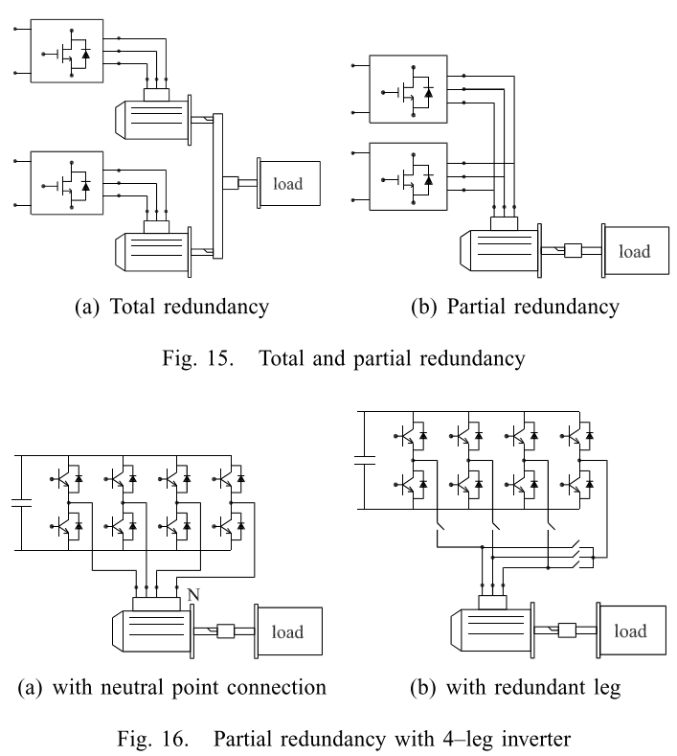
Redundancy

Slide 12
Fault Tolerant Topologies (Standard motor)
Switch-redundant topologies.
An additional leg connected to the neutral point.
An additional redundant leg.
Full H-bridge/cascaded inverters.
Adoption of a delta connection
Use of direct AC/AC matrix converters
Employ current servo amplifiers
All methods require a reconfiguration of both the hardware and the software of the system once a fault has occurred.

Slide 13
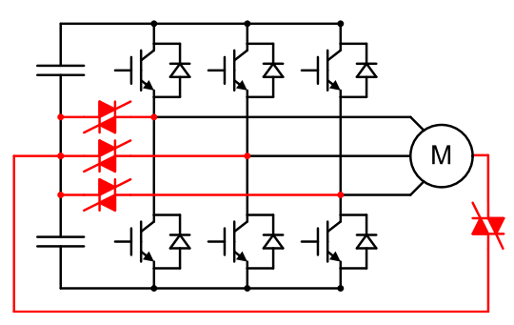
Switch Redundant Topology
TRIACs
SCRs
Power switch open-circuit
Power switch short-circuit
Winding open-circuit

Slide 14
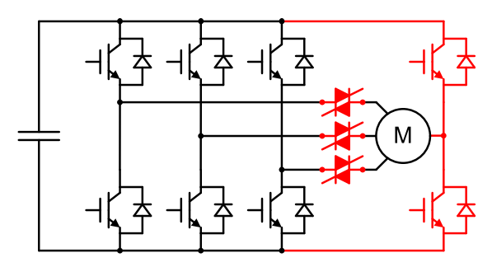
Additional leg (neutral)
Power switch open-circuit
Power switch short-circuit
Winding open-circuit

Slide 15
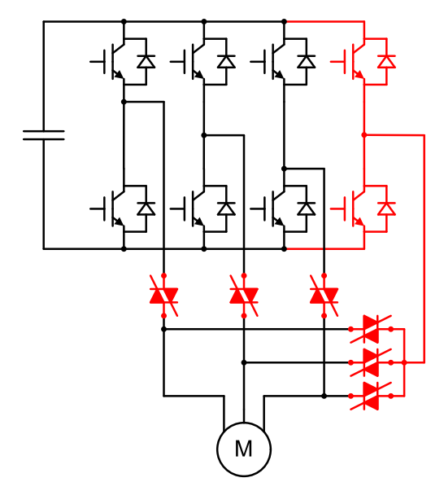
Additional leg (redundant)
Power switch open-circuit
Power switch short-circuit

Slide 16
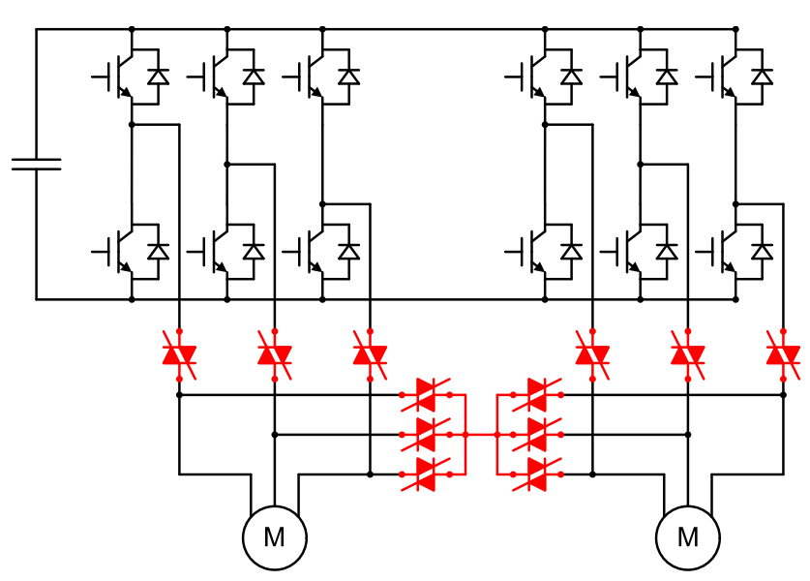
Redundant VSI
Configured to 5-leg
Power switch open-circuit
Power switch short-circuit

Slide 17
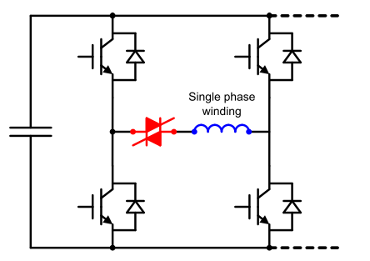
H-bridge Drive
Power switch open-circuit
Winding open-circuit
Due to the increased device count, inverter switching losses increase during normal operation.
Since the semiconductor devices must withstand the phase voltage rather than the line voltage, the power device voltage ratings are reduced and switching losses may even decrease; which, in turn, reduces the heat sink requirements. (Bu doğru değil aslında)
For a 3-phase system, the volt-amperes rating of a full H-bridge inverter is 2/√3 times that of a half-bridge inverter, as the number of power switches doubles, but each switch must withstand only the phase voltage instead of the line voltage.

Slide 18
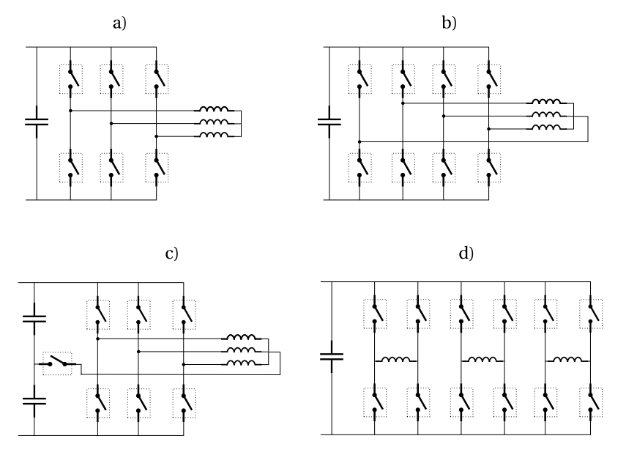
Fault Tolerant Topologies for 3-phase drives
Redundant bridge arm
The product of the number of switches and the rating of each switch (V·I) is increased by a factor 1.15 compared to conventional
Conventional
A phase can be completely short circuited to limit the short circuit current in case of a turn to turn short circuit fault, while it is still possible to control the two remaining phases.
Solution with less switch number

Slide 19
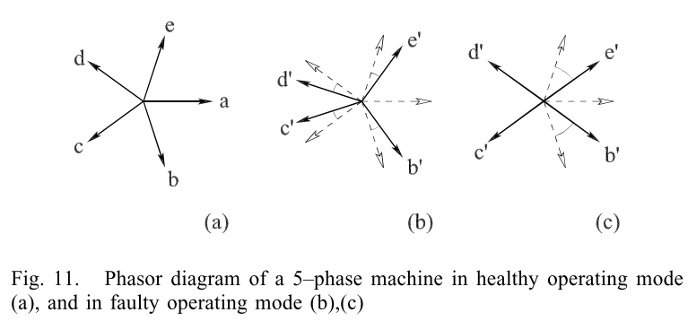
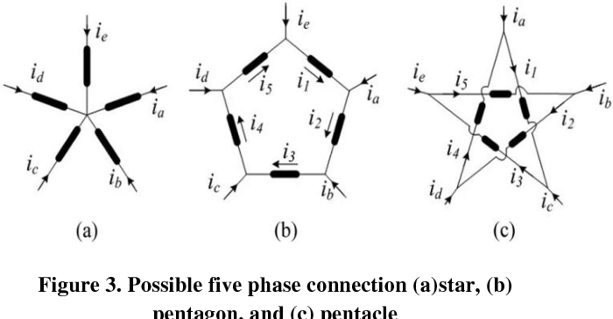
Fault Tolerant Topologies
Magnetic coupling between modules should be analyzed. «In any case, it must be noted that, unless the magnetic coupling between phases is eliminated, no truly independent operation of the individual phases is possible, which may result in an undesirable pulsating torque in the machine.» Buna gelicez.
Limit the short circuit current. Inductance calculation is necessary. Buna da gelicez.
Core loss and magnet loss calculation. Kanayan yara ?
Fault’ta DC bara nasıl davranıyor, incelemeye değer.
The power converter must be equipped with the necessary means to quickly detect and respond to several fault conditions; including, winding open-circuit faults, short-circuit faults, power transistor faults, etc. Fault’lar incelenmeye başlandı.
IMMD Ver.2’de protection devresi şart oğlu şart…
5-faz motor bağlantı tipleri:

Slide 20
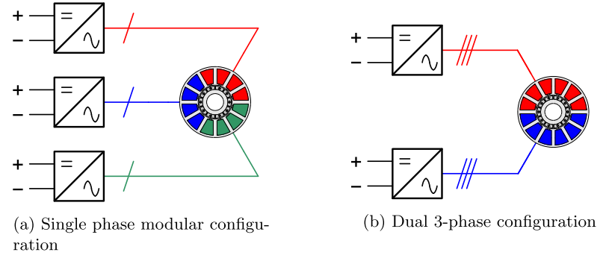
Fault Tolerant Topologies with Modular Motor
Two distinct approaches are usually considered:
Each machine phase is regarded as a single module and the drive is designed so that every phase operates independently. (a)
The second procedure is to have various sets of isolated 3-phase windings that are independently supplied. (b)

Slide 21
Fault Tolerant Topologies with Modular Motor
Single phase: It is required that it is magnetically, electrically, thermally and physically isolated from the rest of phases. These isolation requirements must be fulfilled both at the machine and at the power converter side.
Three phase: In case of a phase fault, the corresponding 3-phase winding is isolated and the drive continues to operate with a reduced power.
The multiple stator windings can be arranged as:
EMF phasor distribution of each 3-phase set is the same (bu bizim durum)
Currents are in-phase
Lower contact between modules
Less mutual coupling
There is an angular displacement between the EMF phasors belonging to different sets (bu uygulasak mı dediğimiz yapı)
Winding sets shifted by an electrical angle of π/3n
Supplied by currents with a delay of 1/6n of a period
Overlapped windings (nötrden?)
Can be supplied as a 3n-phase system: Increase in the winding factor and a reduction of the air-gap MMF harmonic content (torque ripple, rotor losses)

Slide 22
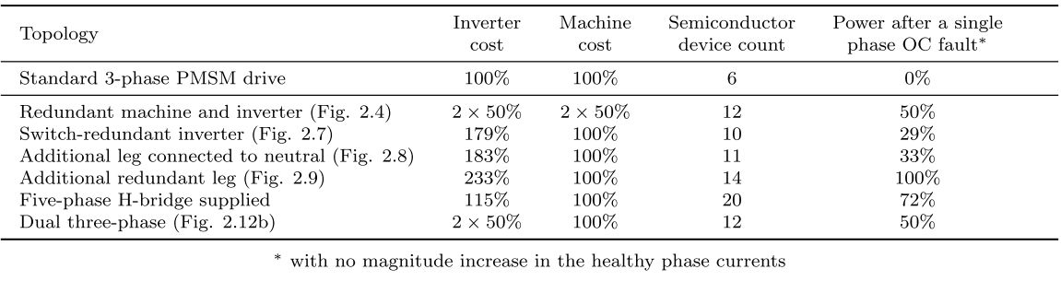
Fault Tolerant Topologies - Comparison
the only one able to sustain multiple electrical faults
Actual cost is higher
can also tolerate more than one electrical fault in different modules when the number of 3-phase winding sets is higher than two.
Bizim durum olabilirmiş, 2-seri, 2-paralel olmasa…

Slide 23
Gelelim winding short circuit mevzusuna (PMSM)
One common approach is to design the PM machine with a high enough phase inductance so as to limit the short-circuit currents to a given threshold.
As a consequence, the power factor at healthy conditions is low.
It must be ensured that the magnetic coupling between machine phases is reduced in order for the current in the faulted phase not to affect the flux linked by the remaining healthy phases.
The braking torque arising from a winding short-circuit fault is another aspect that must be taken into consideration; specially at low speeds.
Different approach: Machines with the magnets located in the stator and different kinds of actuators in order to reduce the PM flux linkage.

Slide 24
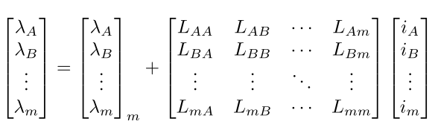
Nedir bu isolation mevzusu ?
Magnetic isolation: Bildiğimiz mutual inductance
Techniques to reduce the mutual inductance:
To employ certain winding configurations that inherently lead to a negligible coupling
In case of SM-PM machines, the air-gap component of the mutual inductance between phases can be reduced with deep magnets together with a nonmagnetic retaining sleeve
In order to reduce the slot leakage component of the mutual inductance, each slot must contain only coils belonging to a single phase. (Bu alternate teeth heralde)
Kendime not: Bizim tasarım ne derece magnetically isolated, Maxwell’de deneyebiliriz. Şöyle ki, sırayla sadece belli fazlara akım versek, diğer fazların (veya modüllerin) endüklenen gerilimlerinde ne kadar değişim olduğuna bakılabilir.
Kendime not: Bizim tasarımı (24 slot) bi de alternate teeth ile denesek mi? Hem performansı vs. nasıl değişiyor hem de yukardakiyle aynı yöntemle mutual coupling ne kadar değişiyor bakılabilir.

Slide 25
Nedir bu isolation mevzusu ?
Electrical isolation: a power switch or winding short-circuit fault may cause the neutral point of the star connection to rise to the DC link voltage, so that the ability to deliver a net torque is lost.
By employing a full H-bridge inverter, each machine phase becomes electrically independent and an additional degree of freedom for machine supply is gained
Although the use of a full H-bridge inverter doubles the number of power semiconductor switches, it only slightly increases the volt-amperes rating of the inverter, as each power switch needs to withstand only the phase voltage instead of the line voltage in a star-connected system.
A 5-phase machine supplied from a half-bridge inverter is capable of delivering a significant amount of torque with a low torque ripple, even after the loss of one phase.
Multi 3-phase’lerde bir faz gittiğinde tüm 3-faz’ı uçurmak gerekiyor. Dolayısıyla örneğin 2 modül varsa 1 faz gittiğinde güç %50’ye düşüyor.

Slide 26
Nedir bu isolation mevzusu ?
Thermal isolation: If no proper thermal isolation between phases exists, the locally generated heat will propagate to neighboring phases, jeopardizing the integrity of the healthy phase windings isolation.
In order to attain an effective thermal isolation between phases, it is necessary that
the phase windings are physically separated
a good thermal path to the cooling surface (most usually the stator outer surface) is provided
Bu konuda bir çalışma yapmak gerekir mi?
Beyin kasırgası:
Loss’un büyük kısmı copper loss olarak statorda çıkıyor. Soğumak için de en iyi yol radial olarak kasadan havaya doğru ısı transferi (diye biliyorum). Aslında back core heigh ile motorun soğuması arasında bir bağ var.
**Additionally, FSCWs are most commonly employed in high pole number machine designs, for which the multi-pole magnetic circuit with small stator yokes can lead to a significant reduction in the machine’s weight and volume. The high slot fill factor and the small stator yoke also provide for a good thermal path between the coils and the machine’s outer surface.

Slide 27
Self-inductance
In case of a terminal short-circuit fault, the short-circuit current in a PMSM is mainly limited by the d-axis inductance; specially at high speeds, when the winding reactance largely dominates over the phase resistance. (low speed’de bu iyice sıkıntı).
This requirement is usually achieved by designing the slot geometry so that a high slot leakage inductance is obtained.
 | Our Design | Required
Ephm | 81 V | 81 V
Iphm | 8.5 A | 8.5 A
Isc | 35 A | 8.5 A (1.0 pu)
Llk | 2.87 mH | Geometri
La | 0.78 mH | Arttırılabilir mi?
Ls | 3.66 mH | 15.16 mH
Power factor | 0.972 | 0.707
Angle | 13.5⁰ | 45⁰
Kabuller:
No saliency
Iphm and Ephm are in-phase
Not a coincidence !
kVA rating %40 arttı.

Slide 28
Self-inductance
Having a high phase inductance results in an increased stator iron flux, if compared to a machine with negligible inductance. This demands that the stator yoke is increased by a factor of √2. Why?
Bir önceki analizde çıkmıştı bu √2. Aslında 1.0 pu değil de arada bir değer yapılsa? Ne şiş yansın ne kebap…
Gözlem: Power factor düştükçe akım artmıyor muydu normalde? Inverter size büyüyordu falan. Önceki analizde bi gariplik var sanki. Gerilim (Vt) 83 V’tan 114 V’a çıktı. DC bara gerilimi yetmiyorsa akımı arttırmak gerekecek. Eph düşük, Iph yüksek yeni bir tasarım mı yapılacak?
H-bridge 3-phase inverter ve inductance üzerine bir analiz:
For a 3-phase system, the kVA rating of a full H-bridge inverter is 2/√3 times that of a half-bridge inverter. (15 %)
Power factor with 1.0 pu inductance is 1/√2 (41 %).
Total kVA rating increases by 2√2/√3 (63%).
The current angle with respect to the back-EMF can be advanced by ψ = 30◦.
This increases the current necessary to deliver the rated torque by a 15%, but reduces the required voltage by a 29%. kVA reduction => 18%.
In total, kVA rating is increased by 34%.

Slide 29
Self-inductance
Remarks:
Fractional-slot concentrated-windings inherently lead to high slot leakage inductances and high air-gap harmonic leakage components due to the rich harmonic content of the armature MMF distribution.
In case of single-layer FSCWs, the increased MMF harmonic content compared to double-layer windings and the higher number of conductors belonging to the same phase in each slot leads to the highest phase self-inductance values.

Slide 30
On stator configurations
3-phase (mostly), 12 slot m/c
Stator-1: All-teeth, physically modular

Slide 31
On stator configurations
3-phase (mostly), 12 slot m/c
Stator-2: All-teeth, physically modular
Nasıl bir fark var?

Slide 32
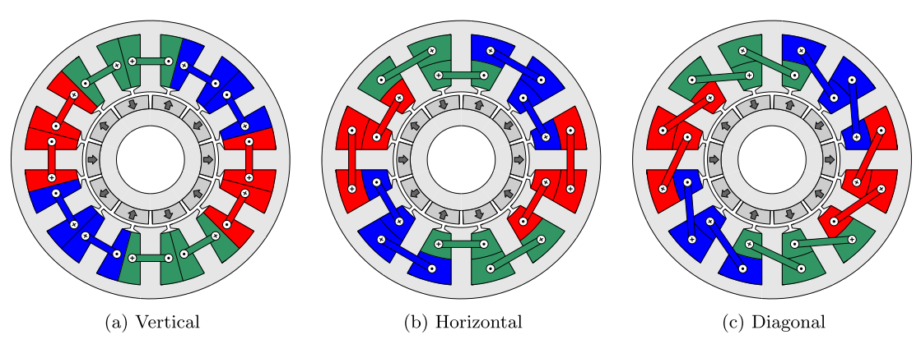
On stator configurations
3-phase (mostly), 12 slot m/c
Stator-2: All-teeth, physically modular
3-phase, Qs = 12, p = 10
Gerçekten varmış böyle şeyler

Slide 33
On stator configurations
3-phase (mostly), 12 slot m/c
Stator-3: All-teeth, shifted modular

Slide 34
On stator configurations
3-phase (mostly), 12 slot m/c
Stator-4: All-teeth, shifted modular

Slide 35
On stator configurations
3-phase (mostly), 12 slot m/c
Stator-5: Alternate-teeth, physically modular

Slide 36
On stator configurations
3-phase (mostly), 12 slot m/c
Stator-6: Alternate-teeth, shifted modular

Slide 37
On stator configurations
Alternate teeth (Single layer)
Higher winding factors
Higher slot fill factor (additional insulation)
Higher phase self-inductance
Lower mutual inductance
Higher physical and thermal isolation (improved fault-tolerant capability)
Easier manufacturing
All-teeth (Double layer)
The end-windings are shorter
The induced back-EMF waveform are more sinusoidal.
Lower air-gap MMF harmonic and subharmonic content (rotor losses, unbalanced radial forces, torque ripple, vibration etc.)

Slide 38
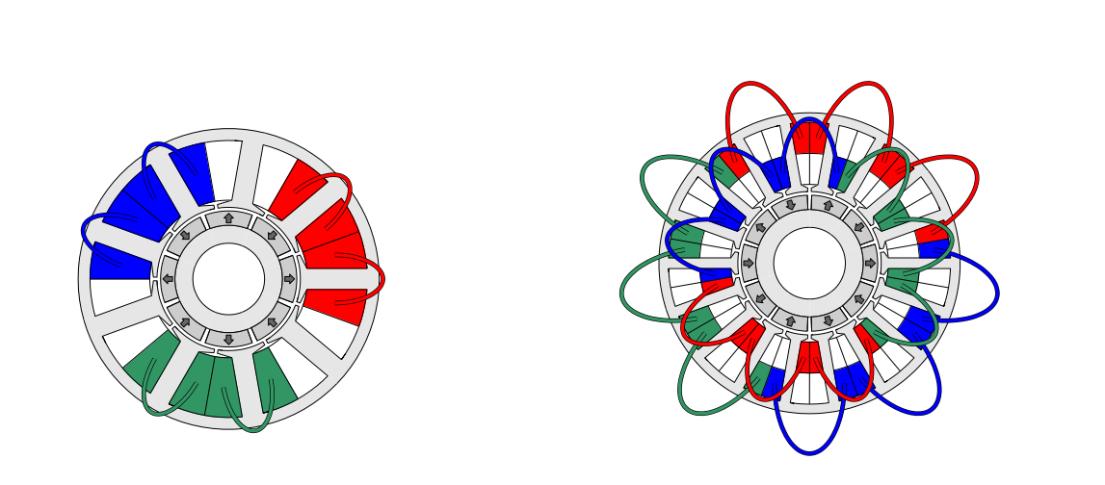
On stator configurations
Four-layer FSCW machine with yq = 2
Mixed single/double-layer

Slide 39
On stator configurations
3-phase (mostly), 12 slot m/c
Stator-7: Alternate teeth, Double stator
Mümkün mü?
Veya bunun all-teeth olanı…

Slide 40
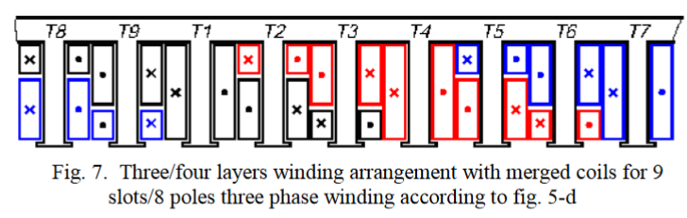
On stator configurations
Şöyle bir şey var:
M. Cistelecan, F. Ferreira, and M. Popescu, Three phase tooth-concentrated multiple-layer fractional windings with low space harmonic content," in Energy Conversion Congress and Exposition (ECCE), 2010 IEEE , Atlanta, GA, USA, September 2010, pp. 1399-1405.
Adopting a higher number of layers helps reduce:
the harmonic content of the armature MMF
the torque ripple
the rotor losses

Slide 41
On stator configurations
3-phase (mostly), 12 slot m/c
Stator-8 (proposed): All teeth, 4-phase, 3-module
Çifte modülerlik:
1-faz gittiğinde bütün modülü kapatman gerekmeyebilir.

Slide 42
On stator configurations
Stator-8 (proposed)
3-phase
4-module
4x6 = 24 transistors
1TF: 75% redundancy
2TF: 50% redundancy
3-phase
4-module
4x12 = 48 transistors
1TF: 92% redundancy
2TF: 83% redundancy
4-phase
3-module
3x8 = 24 transistors
1TF: 92% redundancy
2TF*: 83% redundancy
2TF**: 75% redundancy
* If the second phase is from another module
** If the second phase is from the same module
kVA hesaplama işi anlaşılmadı !
Redundancy hesabında dengesizlik nasıl gözetilecek?

Slide 43
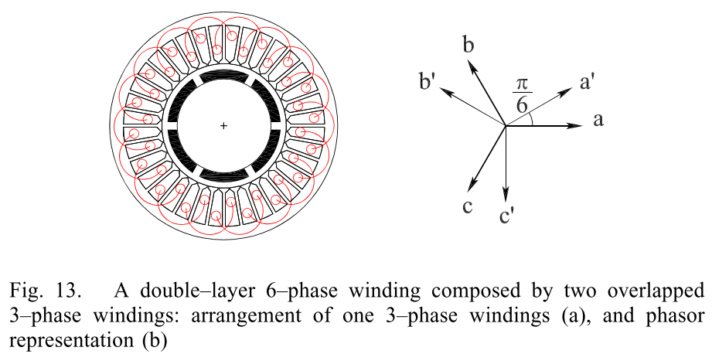
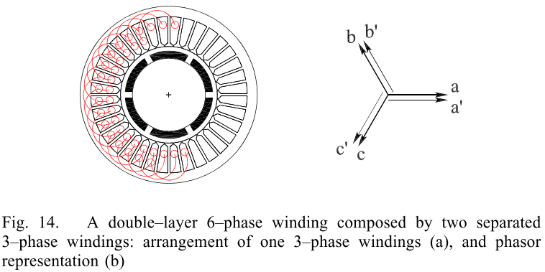
On stator configurations
6-fazlı olsa mesela?
Question:
What is the likelihood of a complete module fault? Control circuit mesela.
Bu soru aslında ‘Faz sayısını neden maksimum yapmıyoruz?’un cevabını verecek.
6-phase
2-module
2x12 = 24 transistors
1TF: 92% redundancy
2TF: 83% redundancy

Slide 44
On stator configurations
Şöyle bir şey varmış:
24-slot alternate-teeth asymmetric six-phase PMSM
24-slot all-teeth asymmetric six-phase PMSM

Slide 45
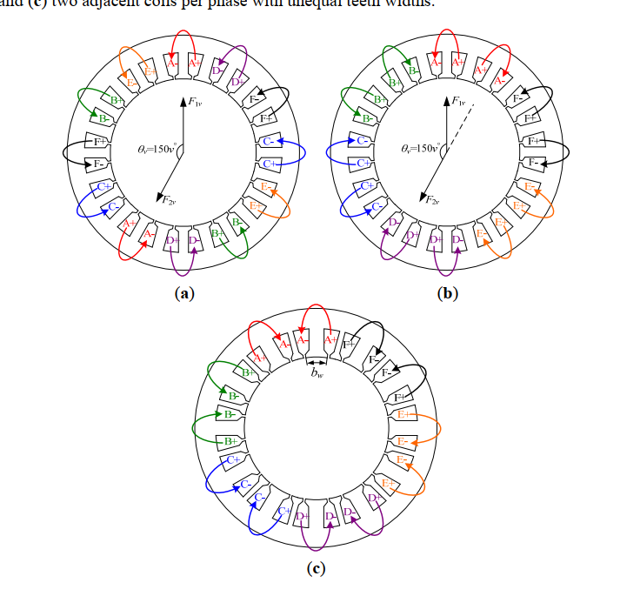
On stator configurations
two adjacent coils per phase
two coils of same phase shifting by 150 degree;
two adjacent coils per phase with unequal teeth widths

Slide 46
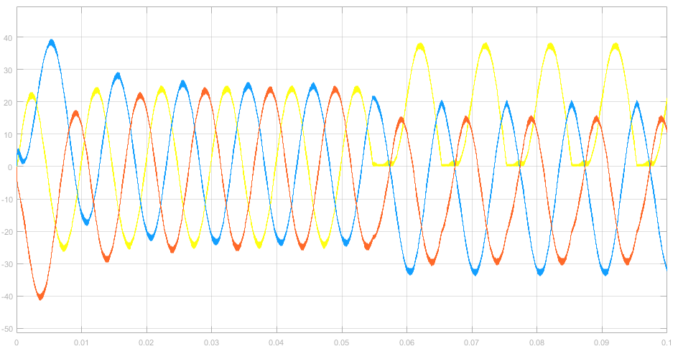
Fault Detection
Transistor open-circuit:
S1’de motor akımı varken (iletimde), S1’i kapatmaya çalıştığımızda kapanmayacaktır ?
S1’e yük binecektir (conduction loss).
Motor faz akımındaki DC’den tespit edilebilir mi?
S1

Slide 47
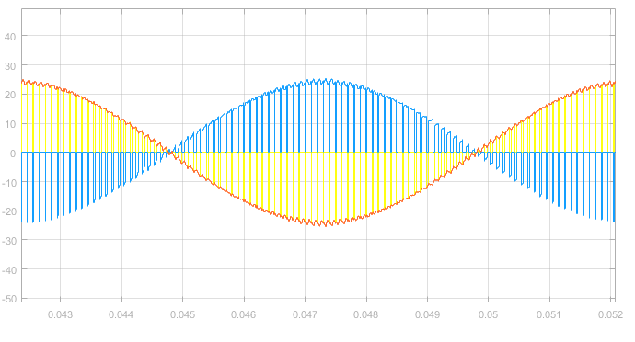
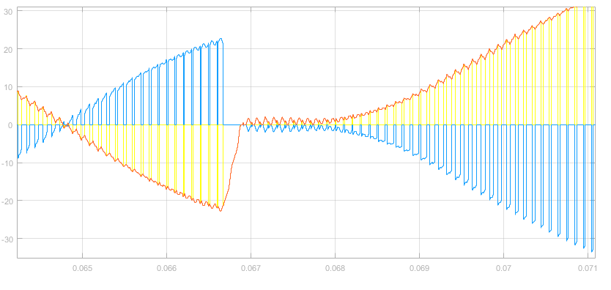
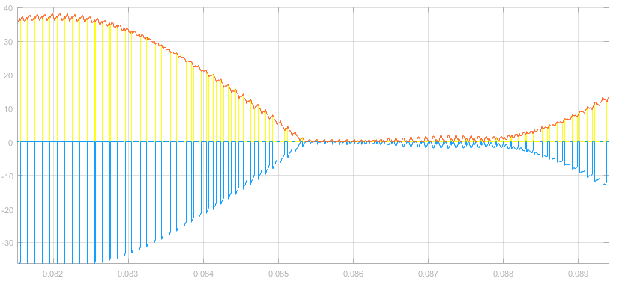
Fault Detection
Transistor open-circuit:
S1
S2
Iphase
IS1
IS2

Slide 48
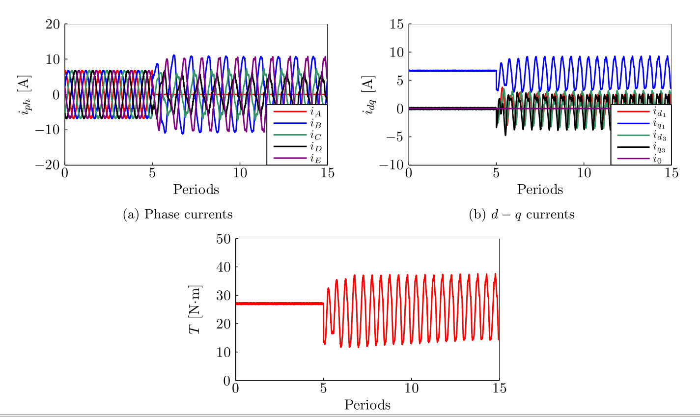
Fault Detection
Open-circuit of a single phase winding (5-phase)

Slide 49
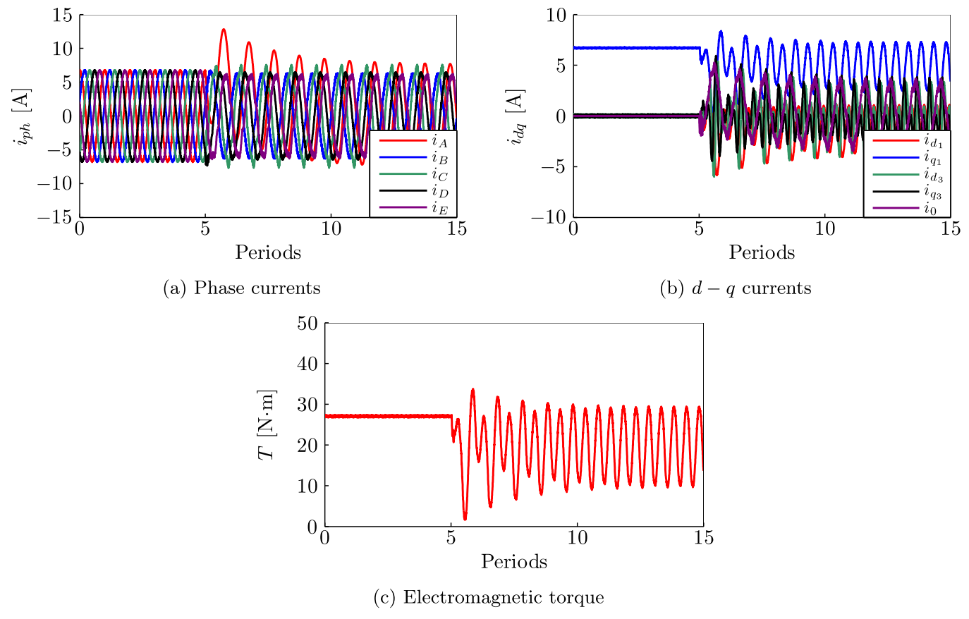
Fault Detection
Short-circuit of a single phase winding (5-phase)

Slide 50
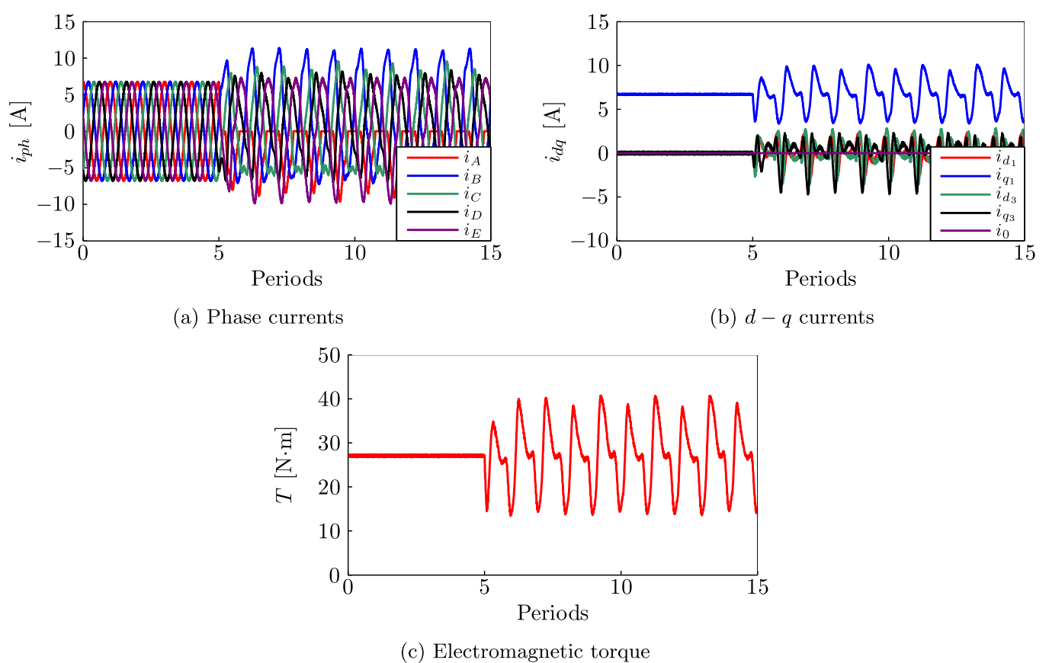
Fault Detection
Open-circuit of a single transistor (5-phase)
Least Serious

Slide 51
Fault Detection
Open-circuit of a single leg (5-phase)

Slide 52
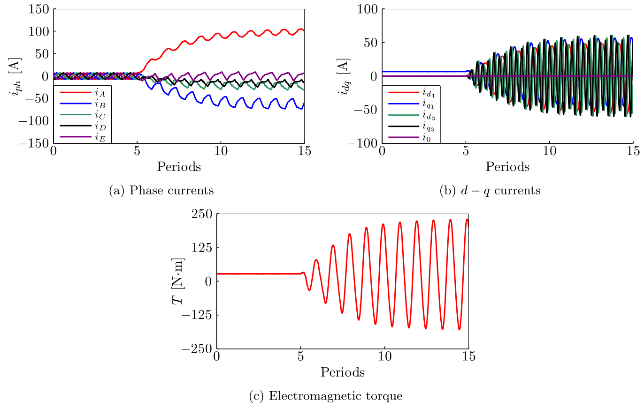
Fault Detection
Short-circuit of a single transistor (5-phase)
The protection circuit responds by immediately opening the transistor in the same leg
Most Serious

Slide 53
Fault Tolerant Operation
Open-circuit of a single phase winding (5-phase)
Recommended that the faulted phase is isolated from the DC bus by turning of the power switches in the corresponding inverter leg. (Not fully isolated)
A full H-bridge is advantageous in this aspect, as the faulted phase can be totally isolated from the DC bus by opening the associated semiconductor switches.
Preserving the main harmonic of the air-gap MMF: Varying the magnitude and angle of the healthy phase currents phasors in order to maintain the main harmonic of the air-gap MMF with respect to the pre-fault state.
PAGE 174

Slide 54
Fault Tolerant Operation
Open-circuit of a single phase winding (3-phase simulation)
Normal operation
Fault without action
Fault with action

Slide 55
Fault Tolerant Operation
Short-circuit of a single phase winding (5-phase)

Slide 56
Fault Tolerant Operation
Open-circuit of a single transistor (5-phase)

Slide 57
Fault Tolerant Operation
Open-circuit of a single leg (5-phase)

Slide 58
Fault Tolerant Operation
Short-circuit of a single transistor (5-phase)

Slide 59
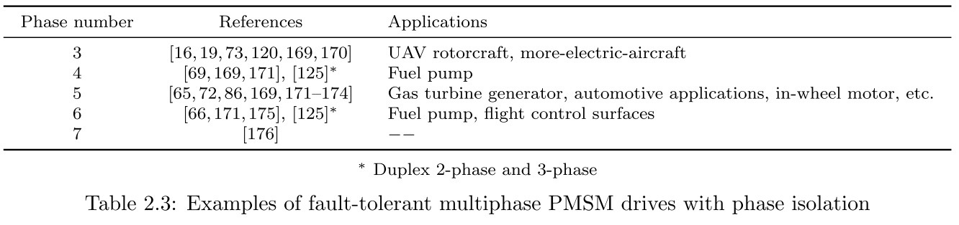
Application
This becomes of the utmost importance in safety critical applications, in which the failure of the system cannot be tolerated.
For non safety critical systems, such as those found in production industry, fault-tolerance can also bring benefits regarding increased running times and longer maintenance cycles.
Aerospace: fuel pump [62,66–69], flap and slat actuators [70–73], cabin pressure control servo-drive actuator [12], drives more-electric-aircraft in general [74–81].
Automotive: traction [82–87], X-by-wire systems (braking, steering, etc.) [65, 88, 89].
Generation: Wind turbine [90–93].
Marine: Propulsion [27, 61, 94, 95].
The use of dual-stator machine designs and redundant drive structures is common in ship propulsion applications

Slide 60
Application
On marine propulsion
Marine electrical propulsion motors have both low volume and mass as desirable characteristics.
Multi-phase machines:
Higher torque density (because windings with higher phase numbers produce fields with lower harmonic content, and, it is claimed, any remaining space harmonic fields contribute positively to the torque).
Greater efficiency (because the stator windings of a multiphase machine produce more fundamentally-distributed current than those of a three-phase machine).
Reduced torque pulsations (because of the reduced harmonic field content).
Greater fault tolerance (because the loss of one phase in, say, a 20-phase drive system still leaves the other 19 phases to produce part of the full-load torque, whereas the loss of one phase in a conventional three-phase system results in a single-phase drive which cannot start and that will produce a massive pulsating torque if it is running).
Simpler, more-reliable power conditioning equipment (because the power is delivered through more than three channels, so that the need for parallel and/or series connection of semiconductor switches may be reduced or removed entirely).

Slide 61
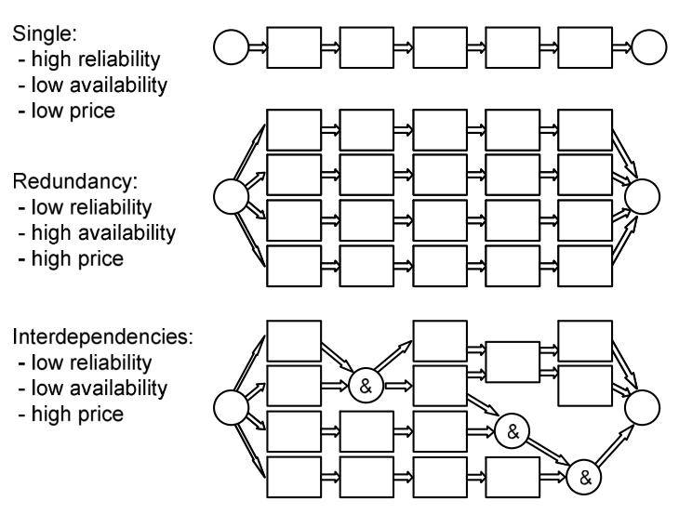
Application
Ship propulsion - Redundancy

Slide 62
Application
Ship propulsion - Redundancy
Most of the cruise ships are configured for two propellers, mostly because of redundancy and feasible power limits of electric drives.
Dual-stator motors supplied by parallel frequency converters are commonly utilized at the highest power ratings, because the maximum current ratings of frequency converters are typically much lower than those of electric motors.
In addition, such solutions provide redundancy and reduce harmonics in the electric system.
Most of the LNG Carriers with electric propulsion are utilizing the single propeller configuration as the conventional ships. The electric part is split into two separate systems giving a 50% redundancy on this part.

Slide 63
Application
Ship propulsion - Redundancy
Full-scale spare system:
Idle in parallel with the main system: Advantageous, when the systems have been designed for optimal performance at full load and process shutdown is allowed in case of faults.
Share the load equally: Beneficial when the reserve power is needed without interruptions and the number of parallel systems is high.
The level of total spare capacity can be reduced by multiple parallel systems, for instance four parallel systems with one redundant system only requires 25% over-dimensioning.
The level of redundancy in such systems is expressed as:
The percentage of available power versus the total rated power in case of a single fault. For example, two or four parallel systems have 50% or 75% redundancy against single faults, respectively.
Question: Paralel olan 2 çevirici durumunda, load power %50’nin altına düşse, 1 çeviriciyi tam yükte kullanmak mı daha verimlidir yoksa 2 çeviriciyi yarım yükte kullanmak mı?
Load power nerelerde seyrediyor bunu öğrenebilir miyiz? (duty olayı). Hem üstteki durum için, hem de mesela 2 modül yapmanın feasible olma durumu artıyor sanki. Normalde full scale redundancy için tüm sistemden bi tane daha koyacakken, bunda 2 tane yarım sistem koyup hala yük karşılanabilir?

Slide 64
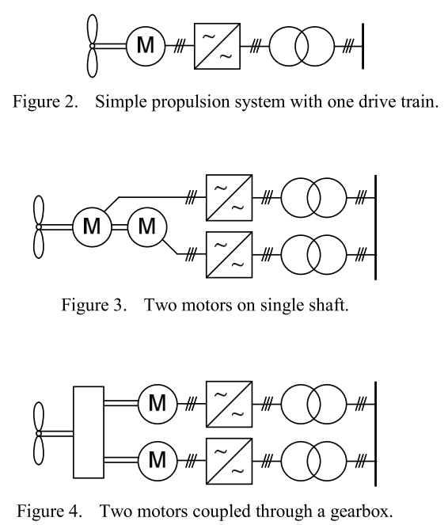
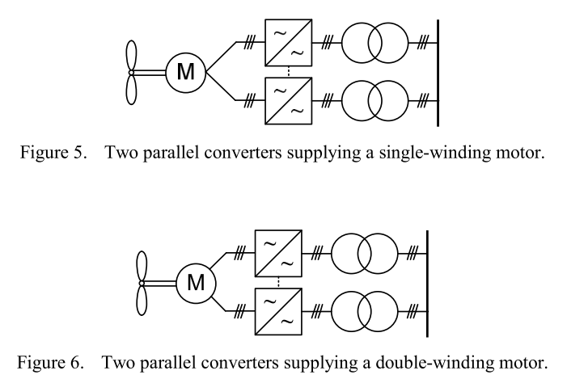
Application
Ship propulsion - Redundancy

Slide 65
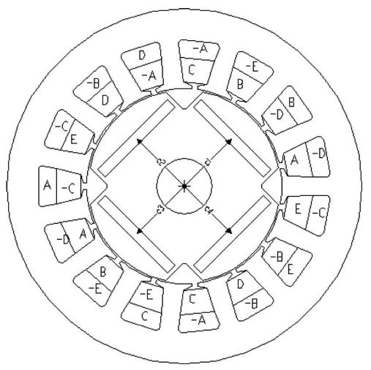
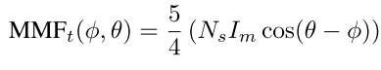
Application
EV-HEV
Increasing number of phases will increase the frequency and decrease the amplitude of torque pulsation.
A zero-sequence component is necessary to provide an undisturbed rotating MMF after one phase is lost.
FIVE-PHASE IPM MOTOR WITH FRACTIONAL SLOT
In this case, the fundamental current amplitude of the healthy phases needs to be increased up to 1.382 time of the initial value when all five phases are functional.

Slide 66
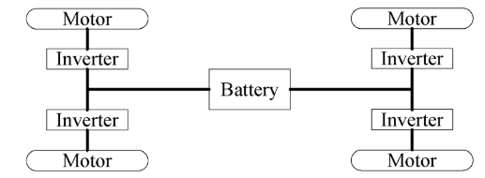
Application
EV-HEV
In-wheel machine topology: four-wheel independently driven technique for Evs, improved efficiency and available space on the vehicle.
IWFT-IPM: In-wheel fault-tolerant interior permanent magnet machine
The outer-rotor topology:
Attractive because it facilitates direct coupling with wheel.
High torque-to-weight ratio.
High efficiency.
The conventional SM PM machine suffers from the weak mechanical robustness. (IPM kullanılabilir)

Slide 67
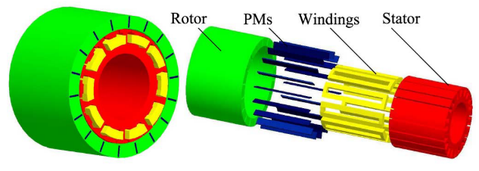
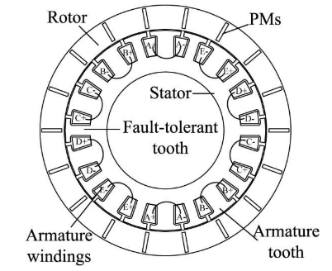
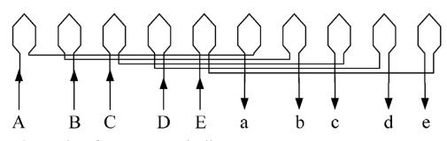
Application
IWFT-IPM
Speed: 1500 rpm
20/18 machine
Do = 237 mm
Dis = 217 mm
Dshaft = 132 mm
La = 80 mm
Rated power: 10 kW
Total weight: 17.3 kg.
Power density: 652.6 W/kg.
Torque: 72 Nm
Torque-to-weight: 4.2 Nm/kg
This scheme can fully utilize the space and greatly reduce the size and weight of the drive system for EV applications.
Electrical, magnetic, thermal, and physical separations of the various phases are achieved indeed, which overcome the drawback about short circuit of various phases.
The width of the armature tooth is two times the fault-tolerant tooth. Hence, the width of flat top of the back-EMF is even more than 144 , which is inherently suitable for five-phase BLDC operation. ???

Slide 68
Application
Five-Phase Modular Permanent-Magnet In-Wheel Motor
40-slot/42-pole
The fault-tolerant tooth was optimized to obtain better torque curve.
Faults: one phase open-circuited, two adjacent phases open-circuited, two non-adjacent phases open-circuited one single phase short-circuited.
The Choice of Phase Number:
Continue to produce the rated power in case of single phase failure. Hence, if the phase number of the machine is N, the power of each phase should be designed to be 1/(N-1) times of the rated power.
In order to realize electric isolation, each phase is driven by a single four-switch inverter.
The probability of phase failure also grows with the increase of phase number.
To choose appropriate phase number, the complexity, cost and fault-tolerant ability of the system need to be considered.
The Choice of Slot/Pole Combination:
Each phase should be an independent module, with no electric, thermal, physical, and magnetic coupling with the others.
Each phase adopt single layer concentrated winding.
The stator slot should be deep enough to obtain large inductance, so as to limit the short circuit current.
Winding factor of single-layer armature winding is smaller. The harmonic components of EMF and MMF of single-layer windings is higher, so the torque pulsation and the noise of the motor is quite severe.

Slide 69
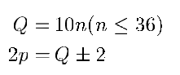
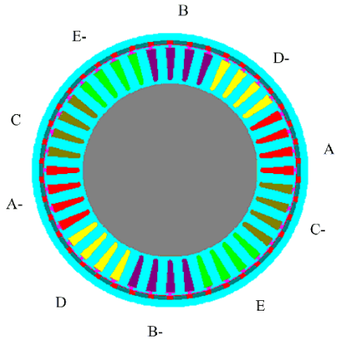
Application
Five-Phase Modular Permanent-Magnet In-Wheel Motor
Considering unilateral magnetic force, even number of slots should be preferred.
Due to the low winding factor of the armature winding, pole number should be close but not equal to the slots number.
If the slots number is Q, the poles pairs is p and n is an integer larger than zero, then the combination could be calculated by (5 faz motor): 40/42
There are four coils for each phase and the electrical angle shift of adjacent phases winding is 72 .
The tooth between adjacent phases is called fault-tolerant tooth. (The unwound teeth between phases). On one hand, they are return path of the main flux. On the other hand, the heat between phases is isolated by the fault-tolerant teeth.
Optimal width of fault-tolerant teeth is found (average torque-torque pulsation)
The stator slots were designed deep enough to obtain large inductance.

Slide 70
Application
In-Wheel Motor (High torque-low speed)
Mounting the EV drivetrain in the wheel of the vehicle has received interest due to:
1) It releases vehicle space for passengers, traction batteries, etc.
2) The torque at each wheel can be independently controlled, giving true four-wheel drive.
3) True wheel-slip-based control allows improved vehicle response and shorter braking distances.
4) The removal of drivetrain components gives vehicle designers greater freedom to design vibration-free more comfortable vehicles.
5) The elimination of gears and differentials produces a simpler and more reliable overall mechanical design.
Problems often perceived with in-wheel motors are related to ride and handling, due to an increase in the vehicle unsprung mass, and safety issues when a motor fault occurs, developing a dangerous torque disturbance.
The motor is made up of a series of three-phase submotors, with each submotor operating independently of the other submotors, so that a fault on any one submotor introduces only a fraction of the torque disturbance that would occur in a full motor.
The machine has also been designed with a relatively large phase inductance through careful shaping of the stator tooth tips: This limits the fault current during a terminal short circuit.
The machine is expected to produce rated torque even when one subunit is lost, an equation for fault-tolerant overrating factor was developed, (n/(n − 1)), where n is the number of subunits.
Each subunit is a three-phase motor, with eight subunits in total. Splitting into three-phase subunits, rather than single-phase ones, is preferable because each subunit draws constant power. The loss of one subunit does not result in significant distortion of the supply current or the introduction of significant output torque ripple.

Slide 71
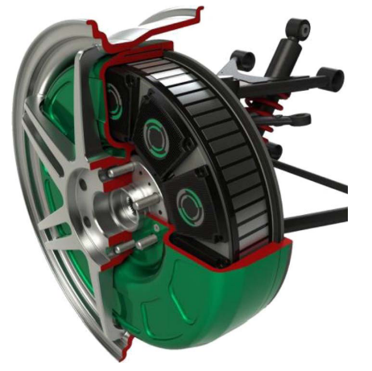
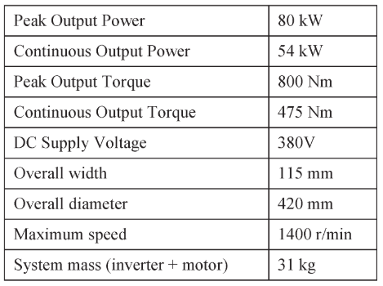
Application
In-Wheel Motor
The motor is part of the Protean Electric in-wheel propulsion system, with the power electronic drive and motor as one packaged unit.
The topology chosen is that of a three-phase radial-field permanent-magnet outer-rotor in-wheel motor, with each in-wheel motor split into eight submotors.
The torque demand is distributed to each of the eight microinverters, where each microinverter drives a submotor. The microinverter and associated submotor are independent from the others in the hub motor except for the common CAN interface signal and the shared dc-bus the PM rotor.
Each microinverter has its own dc-bus bulk capacitance and driver circuits and is individually fused to the dc bus so that an inverter or submotor fault that results in large dc-bus current will blow the dc-bus fuse and hence isolate the fault from the other microinverters in the hub motor.

Slide 72
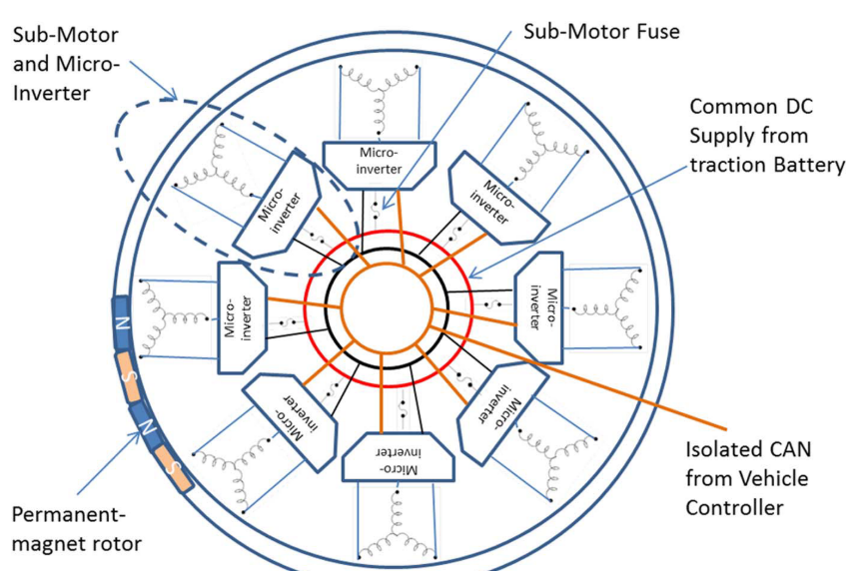
Application
In-Wheel Motor
A series of these motors has been built and extensively tested in a variety of vehicles, ranging from a Volvo C30 to a Ford F150 SUV.

Slide 73
Application
In-Wheel Motor
The outer-rotor design of the motor maximizes the air-gap diameter.
Since the motor is direct drive, the maximum speed requirement of the motor is modest; hence, it is possible to have a large number of poles, resulting in very shallow core backs and creating a “ring” type structure.
The center of the ring is used to house the power electronics.
Windings are concentrated around individual teeth to minimize end-winding length: This simple winding structure also enables a high slot fill factor.
The stator is water cooled, enabling high winding current density and a consequently high magnetic loading. ???
Very torque dense drive system, producing 26 Nm/kg of total mass.
The complete motor has 72 slots and 64 poles.
Each submotor has a relatively large inductance.
Minimizing the likelihood of fault propagation between submotors.
It is important to limit the level of drag torque generated by the motor during a fault, which is a major concern in terms of vehicle safety.
It was found that, the predicted cogging torque is exceptionally low (0.025%).
System studies have revealed that the driver can easily cope with the loss of torque at one wheel—the effect is not major—but a sudden large braking torque in one wheel is far more problematical when traveling at high speed.

Slide 74
Application
In-Wheel Motor
Driver can easily cope with the loss of torque at one wheel—the effect is not major—but a sudden large braking torque in one wheel is far more problematical when traveling at high speed. (Short-circuit faults result in braking torque.)
Potential failures in the drive system include the following:
1) winding open circuit;
2) motor winding short circuit to earth, winding terminal short circuit, or internal turn–turn short circuit;
3) power device failure—either open or short circuit;
4) capacitor failure—open or short circuit;
5) DC-bus open or short circuit;
6) mechanical bearing failure.
Open-circuit faults result in high torque ripple and loss of torque but do not introduce disturbance torque; hence, they are relatively benign.
Short circuits can result in large circulating currents, irrespective of whether they are caused by winding, power device, or capacitor of power supply failure. These currents continue to flow, even if the power supply is removed, because they continue to be driven by the rotor magnets. These circulating currents can result in large disturbance torques.

Slide 75
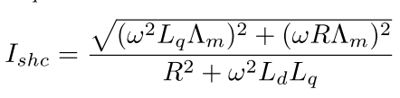
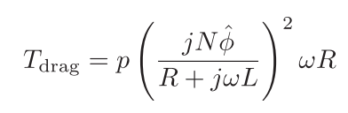
Application
In-Wheel Motor
Each motor is split into a series of submotors, and each submotor is a three-phase motor: The failure of any one submotor only introduces one-eighth of the braking torque of a full motor, while the other submotors can continue to produce motoring torque.
The submotors are designed to have a significant per-unit inductance.
This inductance also allows for significant field weakening.
Experiment:
50 Nm drag torque under one module short circuit fault
It would have been 400 Nm without segmentation (Limit is 240 Nm ??)
Single turn short circuit:
The fault creates a large current in the shorted turn (600 A => FEA result)
This current is an order of magnitude greater than the thermal limit of the machine
The reason is that the single turn has a very low inductance (Ef de küçük ???)
The resulting drag torque is very low
The short-circuit current is limited by the winding resistance at lower speed (increase with speed).
At high speeds, the short-circuit current is limited by just the winding inductance and becomes independent of speed.

Slide 76
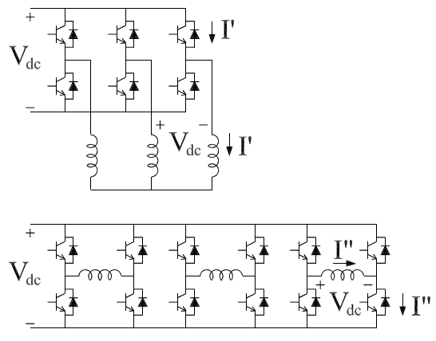
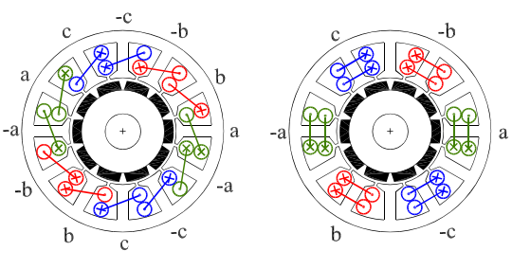
Application
On Fault Tolerance in Traction Applications
Some electrical motor drive solutions designed to cut down the fault occurrence:
an electrical phase separation, in order to limit the electrical interaction,
a physical phase separation, in order to prevent a phase– to–phase fault,
a phase inductance as high as to limit the short–circuit currents.
a low or null mutual inductance among the phases
Our motor

Slide 77
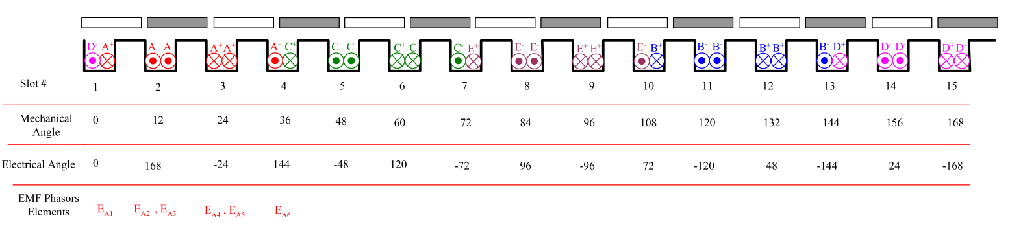
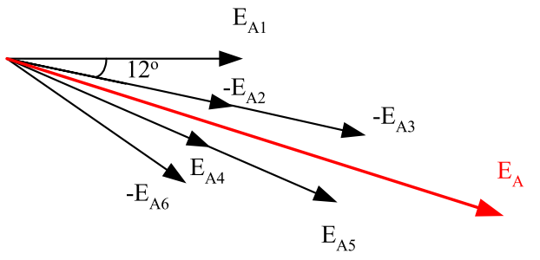
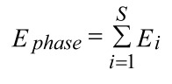

Application
On Fault Tolerance in Traction Applications
5-faz motor
Biz skew’ı dikkate almadık !!!

Slide 78
Application
On Fault Tolerance in Traction Applications
The concentrated windings machines with slot/ pole ratio of 1.5 which is widely used in application such as in Toyota Prius (i.e. 12 poles, 18 slots) offer a winding factor of 0.866.
This means that the current density 13.3% and in result, copper losses 33.3% are higher as compared to a distributed windings machine for the same amount of torque, with assuming same slot fill factor, same electromagnetic design and disregarding the end losses.
It appears that while a terminal short circuit can be accommodated, a single turn short circuit can not be tolerated.
Least common multiple (LCM) of the number of slots and number of poles (420) that determines the cogging torque frequency.
=> 120 in our case.
=> 264 with 24/22 machine

Slide 79


Application
Aerospace – PM Alternator (PMA)
The principal reason for a dedicated generator as part of the engine control electronics suite is due to the prevent loss of aircraft power causing a thrust control failure on a large civil aircraft.
Four star connected, 3- phase independent outputs (complete machine must allow galvanically isolated sub-machines)
It is shown that the power ripple might be reduced by about 12% and un-balanced windings can be significantly balanced by thickening up the SMC slot wedges between the sub-machines.
The PMA spends much of the time at short circuit to limit the output power. Therefore, high speed losses might be of importance in the machine. ???
An SMC slot wedge material, Somaloy 700HR3P (by Höganäs). umax = 770. SMC wedge material saturates at lower magnetic field (≈ 1.1 T).

Slide 80




Application
Aerospace – PM Alternator (PMA)
28 slot – 18 pole and 24 slot – 20 pole PMAs (having the same volume envelope).

Slide 81


Application
Direct-Drive Permanent Magnet Motor for a UAV Rotorcraft
The motor is divided into a number of discrete 3-phase machines in parallel on the same stator.
The control ensures that balanced operation is maintained during a fault by, for example, in the case of a short-circuit fault, imposing a short on all three phases of the faulted group.

Slide 82

Application
Direct-Drive Permanent Magnet Motor for a UAV Rotorcraft
Trade-off between overrating factor (or degree of fault tolerance) and compexity (and cost)
2 machine module configuration would require an excessively overrated drive to compensate for half the loss of power from a fault.
6 machine module configuration would require an excessive number of switches.
36 slot design would increase the complexity of manufacture.
Decided to use a four machine module configuration on a 24 slot motor. (Bizimki)
It should be noticed that the six independent phase module configuration has the same total number of drive switches.

Slide 83




Application
Direct-Drive Permanent Magnet Motor for a UAV Rotorcraft

Slide 84

Application
Direct-Drive Permanent Magnet Motor for a UAV Rotorcraft

Slide 85

Traction ?
Pirius
Machine Volume: 4.774 l
Power density: 10.47 kW/l (peak power)
Speed: 6000 rpm
Our design
Machine Volume: 7.729 l
Power density: 1.04 kW/l (peak power)
Speed: 600 rpm
Coincidence ?
What are the limations for us for designing a high speed machine ?
Water cooling (high power)
Test setup
Mechanical parts
Tip speed
Core loss
Winding extra losses, litz wire?

Slide 86
High speed design
We are here !

Slide 87
High speed design
As the speed increases (same P):
Torque ↓
Dimensions ↓
Pole area ↓
Flux ↓ (13 kat)
Frequency ↑ (50 kat)
Coil voltage ↓ (3.5 kat)
Number of turns ↓ (3.5 kat)
Bu tasarımda aynı DC Link voltajı ve aynı modül sayısı var. Bu durumda faz gerilimi sabit. Tork çok düşmesine rağmen aynı akım var drive’da. Haliyle verimi hep aynı gidiyor.
Question: Böyle mi olmalı ?
Bu analizlerde core loss yok, yani aslında var da frekanstan etkilenmiyor.

Slide 88
High speed design
Derken GaN’ları içeren şöyle bir analiz yaptım:
60A GaN bölgesi
30A GaN bölgesi
60A GaN bölgesi
30A GaN bölgesi
En düşük 24A, en yüksek 10A faz akımı var.
Hesap: Tepe akımı x 1.5 kat marjin
Question: 60 Amperlik GaN kullansam hep, ne olur? Apart from cost…

Slide 89
High speed design
Farklı transistör seçimleri:
Margin: 2
Margin: 1.2
60A GaN bölgesi
30A GaN bölgesi
60A GaN bölgesi
30A GaN bölgesi

Slide 90
High speed design
Loss dağılımları:
Core loss’u hesaplayabilmeliyiz !

Slide 91
High speed design
Volume and Power Density:
Reduction in motor volume is obvious.
There is no change in the capacitor volume.
Drive volume reduces since the outer stator diameter reduces.
Heat sink required thermal impedance does not change.
Heat sink length increases since area is reduced.
In total, heat sink volume is decreased. Bu yanlış olabilir ! Bunu incelemek lazım.
PCB’ye tüm elemanların sığdığı varsayılıyor !

Slide 92
High speed design
Volume and Power Density:
Bu da böyle bir anımdır.
Tabi burada da yine aynı assumption var (PCB komponentleri sığıyor).

Slide 93
Fractional Slot Concentrated Winding Machines
The usual criteria for the choice of the number of phases, poles and slots:
Winding feasibility
Non-overlapped coil windings
Modularity
Winding factor
Radial forces
Cogging torque and torque ripple
Rotor losses
MMF subharmonics
Peak armature reaction (MMF sub-harmonic ile alakalı bu da)
Self-inductance
Mutual inductance between phases
Number of phases

Slide 94

Fractional Slot Concentrated Winding Machines
Winding factor
24/22 (sanırım)
Biz burdayız
Anladığım kadarıyla, kutup sayısı stator oluk saysına ne kadar yakın olursa o kadar yüksek kw elde ediyoruz, zaten flux linkage’ı düşününce çok mantıklı. Ama eşit yapamıyoruz çünkü cogging torque var. Bu yüzden ‘’as close as possible’’.
Biz 24/22 yapabilirmişiz aslında.
Alternate teeth yapmak da arttırıyor. Tabi modül sayısı 2 olacaktı.
30/26 motorda (1-layer), 3 fazda kw = 0.936, 5 fazda kw = 0.964.

Slide 95

Fractional Slot Concentrated Winding Machines
Radial forces
gcd(2p,Q) > 1: Periodicity
Bu bizde 4. >= 22 kutup olsa 2 oluyor.
1-layer, 3-phase machines.
9/8
12/10
An adequate rule to design FSCW machines with respect to the magnetic forces is that the number of winding periodicities is an even number and sufficiently high.

Slide 96
Fractional Slot Concentrated Winding Machines
Cogging torque
Np = 2p/gcd(2p,Q)
Bu bizde 5. => 22 kutup olsa 11 oluyor.
Having a high value of Np leads to a high frequency and low amplitude cogging torque.
!!! The requirement of having a low number of periodicities to reduce the cogging torque is detrimental to reduce the radial forces in the air-gap, so a compromise between both criteria must be met.
Parameter | 24/20 | 24/22
gcd(2p,Q) | 4 | 2
Periodicity | 4 | 2
Np = 2p/gcd(2p,Q) | 5 | 11
Radial forces | Low | Mod
Cogging torque | Mod | Low

Slide 97
Fractional Slot Concentrated Winding Machines
Rotor losses
Rotor losses in PM machines are caused by;
the existence of flux pulsations due to the stator slots
the presence of air-gap MMF harmonics
!!! When the machine is designed with open slots and 1-layer FSCWs, the flux pulsations may be very high; specially when 2p ≈ Q and the pole-pitch is close to the slot-pitch, leading to high rotor losses.
Techniques to reduce rotor losses:
Laminated rotor
Axial and/or circumferential segmentation of the permanent-magnets ???
Use of a higher resistivity PM material (e.g. bonded vs sintered)
Shielding by copper cladding ???

Slide 98


Fractional Slot Concentrated Winding Machines
Rotor losses: MMF harmonics
Integral slot vs fractional slot (bu bildiğimiz ve boyun eğdiğimiz bir şey)

Slide 99


Fractional Slot Concentrated Winding Machines
Rotor losses: MMF harmonics
Layer sayısı karşılaştırması
Buradaki trade-off: isolation vs MMF harmonic content
In general terms, rotor losses tend to decrease when the number of poles and slots increase, while keeping the same 2p/Q ratio. => Qs ve p arttıkça, yüksek katman sayısının yarattığı avantaj azalıyor.

Slide 100
Fractional Slot Concentrated Winding Machines
MMF sub-harmonics
MMF subharmonics are those with harmonic order ν < p.
Almost all FSCWs, except those with q = 1/2, lead to armature MMF subharmonics
The lower the number of layers for a particular combination, the higher the MMF subharmonic content.
Sub-harmonic
(Baya farkediyor)
p = 5
Have more adverse effect on rotor losses due to being low order
Another consequence of MMF subharmonics is an unbalanced saturation of the iron parts among the rotor poles.
MMF subharmonics lead to low order radial forces between the rotor and the stator of the machine.

Slide 101
Fractional Slot Concentrated Winding Machines
MMF distribution – Our machine

Slide 102
Fractional Slot Concentrated Winding Machines
MMF distribution – Our machine
Fundamental
(10)
(14)
Sub-harmonic
(2)

Slide 103
Fractional Slot Concentrated Winding Machines
MMF distribution – Our machine with 1-layer

Slide 104
Fractional Slot Concentrated Winding Machines
MMF distribution – Our machine with 1-layer
Fundamental
(10)
(14)
Sub-harmonic
(2)

Slide 105
Fractional Slot Concentrated Winding Machines
MMF distribution – Our machine – Layer Comparison
1-layer
Fundamental
(10)
2-layer
(14)
Sub-harmonic
(2)

Slide 106

Fractional Slot Concentrated Winding Machines
Peak Armature Reaction
Peak armature MMF reaction is related to the high amplitude of MMF sub-harmonics.
1-layer FSCWs lead to the highest peak value of armature reaction.
High armature reaction can lead to undesirable local saturation, permanent magnet demagnetization, unbalanced magnetic pull, decrease of the average torque and increased torque ripple.

Slide 107

Fractional Slot Concentrated Winding Machines
Mutual Inductance
1-layer FSCWs do not give rise to a slot leakage component of the mutual inductances and yield a reduction of the mutual inductance with respect to the 2-layer windings.
The coil throw must equal one slot, yq = 1. ( yq = round(Qs/(p) ) => 1 in our case.
The number of spokes in the star of slots must be an even number: ( t = gcd(pp,Qs) )
Q/2t must be even for 1-layer windings
Q/t must be even for 2-layer windings
Q/t = 12 and Q/2t = 6 in our case.
A special case arises for 2-layer windings for which 2p = Q±2t. In these cases, adjacent teeth are wound by coils belonging to the same phase but opposing sign. (20 = 24 ± 4 in our case). When a non-linear, saturable stator material is used, such as a commonplace silicon steel lamination, an undesirable mutual coupling between phases may arise due to magnetic saturation. => 1-layerda problem.

Slide 108
Fractional Slot Concentrated Winding Machines
Inductance Criteria
Magnetizing flux across the air-gap
Leakage fluxes:
Crossing the air-gap: differential leakage flux.
Not crossing the air-gap: slot, pole, tooth-tip and end-winding leakage fluxes.
In permanent magnet machines, the slot and air-gap components of the inductance tend to dominate over the rest.

Slide 109



Fractional Slot Concentrated Winding Machines
Inductance Criteria
Slot leakage:
λslot : permeance coefficient
lef : effective length
Ns : # of series turns/ph
p : pole pair
STOP HERE !

Slide 110


Fractional Slot Concentrated Winding Machines
Inductance Criteria
Comparison:

Slide 111
Fractional Slot Concentrated Winding Machines
Inductance Criteria
Comparison:
For 1-layer, the slot mutual inductance between phases is intrinsically null
For 2-layer where m = 3, 5 and 7, there are combinations (2p ≈ Q) that lead to a reduced mutual coupling between phases, while keeping high winding factors.
For 2-layer where m = 4 and 6 are not suitable for fault-tolerant PMSMs since they do not simultaneously give rise to low mutual inductances between phases and high winding factors for the main harmonic. !!!
For 4-layer, they are not appropriate for fault-tolerant applications, as they generally lead to lower self-inductances and higher mutual inductances.

Slide 112
Fractional Slot Concentrated Winding Machines
Inductance Criteria
Summary:
Lowest mutual inductance values are obtained for 1-layer windings with Q/(2mt) even. Combinations for which 2p/Q ≈ 1 are particularly advantageous, as they lead to high winding factors and minor mutual to phase inductance ratios.
Even phase number 2-layer FSCWs are not suitable for fault-tolerant designs, as they do not simultaneously give rise to high main winding factors and mutual inductances as reduced as when the number of phases is odd.
Lowest self-inductance and highest mutual inductance values are obtained for 4-layer FSCWs, making them inappropriate for fault-tolerant applications.
In order to be valid for even phase number FSCW machines as well, the rule to obtain a negligible mutual inductance:
Q/(2mt) must be even for 1-layer windings (=1.5 in our case) 4-faz olsa
Q/(mt) must be even for 2-layer windings (=3 in our case) 4-faz olsa
22 pole olsa 2-layer oluyor !!!

Slide 113


Fractional Slot Concentrated Winding Machines
Motor datası, Dursun bi yerde

Slide 114
Fractional Slot Concentrated Winding Machines
Fault Tolerant PMSM Design
Application specifications:
Nnom - Corner or base speed
Nmax - Maximum speed
Tnom - Rated torque
Tmax - Maximum torque the machine is able to deliver during temporary service
Pnom - Rated output power
Pmax - Maximum power the machine is able to deliver during temporary service
Unom - Rated phase voltage (RMS)
Inom - Rated phase current (RMS)
Imax - Maximum phase current during temporary service (RMS)
Burada base speed, max speed, max torque vs biz bunları düşünmedik.

Slide 115
Fractional Slot Concentrated Winding Machines
Fault Tolerant PMSM Design
Initial data:
A - Electric loading or linear current density [A/m].
Bagap - Air-gap flux density due to the magnets (peak value of the main harmonic) [T].
Bt- Stator tooth flux density (peak value) [T].
By,r - Rotor yoke flux density (peak value) [T].
By,s - Stator yoke flux density (peak value) [T].
g - Air-gap thickness [m].
j - Slot current density [A/m2].
αPM - Magnet arc width referred to the pole-pitch, 0 < αPM < 1.
Tw - Winding temperature [◦C]. winding temperature of 100 ◦C
TPM - Permanent magnet temperature [◦C]. 100 ◦C for NdFeB magnets to
Sıcaklık hariç bildiğimiz şeyler

Slide 116

Fractional Slot Concentrated Winding Machines
Fault Tolerant PMSM Design
Burada farklı olarak:
Bakır kaybı ve mıknatıs kaybını termal modele sokarak ısınmalara bakıyor
Bu modelde akışkan analizi ile elde edilen konveksiyon katsayısı kullanılıyor
Mekanik davranışına bakılıyor (vibrasyon, gürültü, üretilebilirlik vb.)
Mekanik modelden sürtünme kaybı, hidrolik modelden rüzgarlanma kaybı hesaplanıyor
Sonuç: Bunların çoğuna sadece gol yememek için ihtiyaç duyarız. Onun dışında «mükemmel motor» hedeflemediğimiz için gerek yok. Girilebilecek konular:
Kayıp hesapları
Biraz termal model
Sıcaklık değerleri

Slide 117


Fractional Slot Concentrated Winding Machines
Fault Tolerant PMSM Design
Termal ile ilgili
The most sensitive machine elements to the effect of high temperatures are the insulation covering the copper conductors and the permanent magnets.
The motor insulation lifetime heavily depends on the temperature, with a rule of thumb stating that for every 10 ◦C increase in temperature, the insulation lifetime is reduced by 50%.
PM magnetization curve varies widely with temperature, being the higher the temperature, the higher the risk of demagnetizing the magnets.
Magnet’lerde de genelde lineer kabul ediliyormuş:

Slide 118

Fractional Slot Concentrated Winding Machines
Fault Tolerant PMSM Design
?

Slide 119



Fractional Slot Concentrated Winding Machines
Fault Tolerant PMSM Design
Temel hesaplar
Saliency yok kabul edilirse, $T=\frac{m p}{2}\left(λ_{m} i_{q}\right)$

Slide 120




Fractional Slot Concentrated Winding Machines
Fault Tolerant PMSM Design
A minimum stator yoke thickness to slot height ratio of hy,s/h = 0.25 has been imposed !!!
In a PMSM, having a small air-gap helps saving magnet material, but at the same time, increases iron losses due to slot permeance and armature MMF harmonics. (R düşüyor)

Slide 121



Fractional Slot Concentrated Winding Machines
Fault Tolerant PMSM Design
Embrace

Slide 122
Fractional Slot Concentrated Winding Machines
Fault Tolerant PMSM Design – Case Study
Parameter | Case | Our m/c | Parameter | Case | Our m/c
Phase, m | 5 | 3 | Elect per, t | 1 | 2
Module, n | 2 | 4 | Lm | Negligible | Low ?
Layer, l | 1 | 2 | Coil throw, yq | 1 | 1
Slot, Qs | 20 | 24 | Overlap | No | No
Pole, p | 22 | 20 | kw | 0.9877 | 0.933
Speed, Nr | 600 rpm (b) | 600 rpm | gcd (2p,Q) | 2 | 4
Frequency, fs | 110 Hz | 100 Hz | Radial force | No net | No net
Torque, Tm | 27 Nm | 127 Nm | Np | 11 | 5
Power, Pm | 1.7 kW | 8 kW | Cogging torque | Very low | Low
DC Bus, Vdc | 300 V | 270 V | Low order harm | High | Low
Phase volt, Vph | 100 Vrms | 86 V | lg | 1.5mm | 1.5mm
Dos | 166 mm | 270 mm | Vm | 2.6 l | 7.7 l
La | 120 mm | 135 mm | PD | 0.65 kW/l | 1.04 kW/l
 |  |  | A, J | 35, 4 | 35, 4

Slide 123


Fractional Slot Concentrated Winding Machines
Fault Tolerant PMSM Design – Case Study

Slide 124


Fractional Slot Concentrated Winding Machines
Some experimental stuff
PM machine has been driven by an asynchronous machine in order to perform the standard open-circuit and short-circuit tests.
2) Machine has been operated in motoring mode to conduct various dynamic tests, both under healthy and fault conditions.
1000 pulses/rev. incremental encoder (Omron E6B2-CWZ1X 1000P/R 2M).
Standard voltage probes
Hall effect 30 ARMS current probes (LEM PR30).
A 50 N·m torque transducer
10 resistance thermometers (Pt100):
5-slot (per phase)
5 end-winding (per phase)
Dynamometric set (Magtrol 2WB115+2PB115) allows to operate in between 0 and 15000 rpm and absorb loads up to 30 kW.
Two 3-phase rectifier + IGBT inverter modules (Semikron SEMITEACH - IGBT), from which five of the total six inverter legs have been used.
Drive gate signals by dSPACE DS1104
DC bus 300 V and fsw 5 kHz.

Slide 125


Fractional Slot Concentrated Winding Machines
Some experimental stuff
Phase resistance and inductance measurements
LCR meter (Hioki 3522-50 LCR HiTESTER).
DC and different frequencies.
Open-circuit test
Back-EMF: For a number of speeds, ranging from 0 to 1000 rpm.
PM flux linkage for different harmonics ?
Back-EMF vs speed characteristic
Measured back-EMF waveform at 600 rpm
Short-circuit test
Connecting all the phase windings together at their input and output terminals.
For a number of speeds, ranging from 0 to 1500 rpm.
The main measured variables: phase short- circuit currents and the braking torque.

Slide 126
Fractional Slot Concentrated Winding Machines
Some experimental stuff
Tests under healthy operating conditions
Page 190

Slide 127
Fractional Slot Concentrated Winding Machines
The End !

